Slide 1
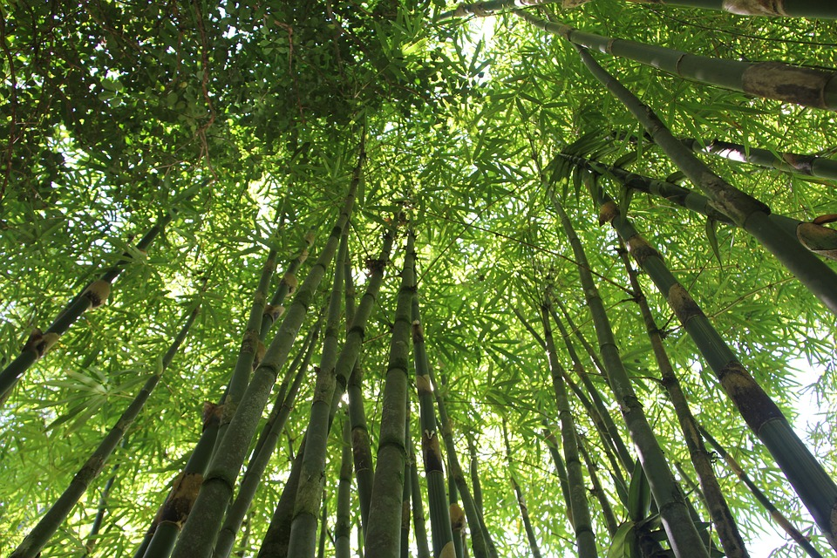

Structural Integrity of Bamboo as A Sustainable Building Material
INTRODUCTION
In recent years, bamboo has emerged as a versatile and sustainable building material due to its exponential growth, strength, and flexibility. Its primary applications range from constructing walls and roofs to scaffolding, which is important in regions prone to earthquakes. Although bamboo offers eco-friendliness, affordability and durability, challenges like susceptibility to pests and fungi highlight the need for proper maintenance. This article delves into the properties, advantages, and limitations of bamboo, giving evidence to its potential to transform modern construction in an environmentally sustainable manner.

Slide 2
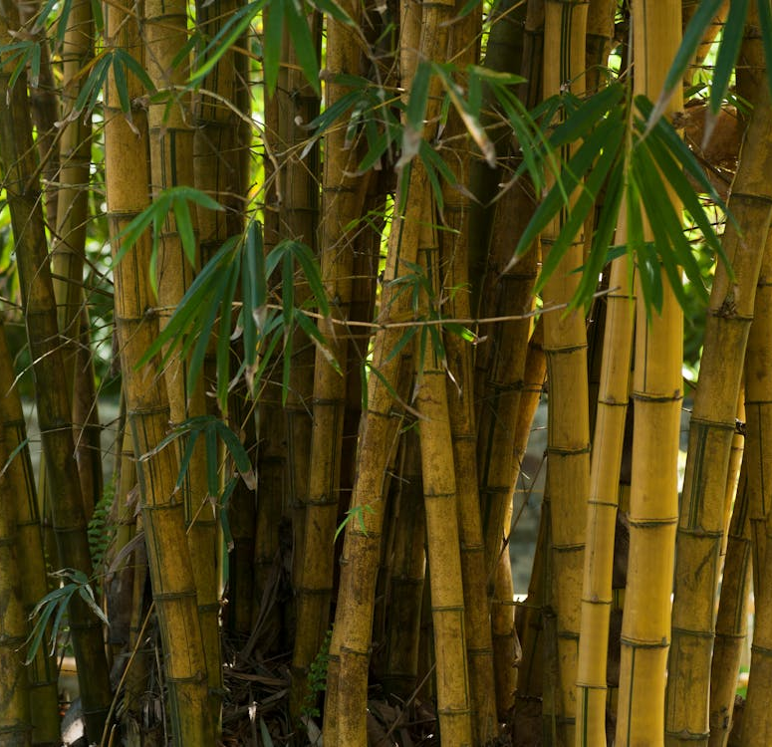
MECHANICAL PROPERTIES
Tensile Strength:
Bamboo's fibers offer significant resistance to pulling forces.
Tensile strength ranges between 100-400 MPa.
Stronger than most construction-grade timbers.
Compressive Strength:
Withstands compressive forces between 40-80 MPa.
Higher compressive strength than most woods.
Ideal for load-bearing applications.
Elastic Modulus:
Stiffness and resistance to bending.
Modulus of elasticity in bending up to 20 GPa.
Superior strength-to-weight ratio compared to traditional hardwoods.
Density:
Density of 500-800 kg/m³ for common species like Moso and Gadua.
Lower density than concrete and steel.
Suitable for lightweight construction needs, especially scaffolding and roof structures.

Slide 3
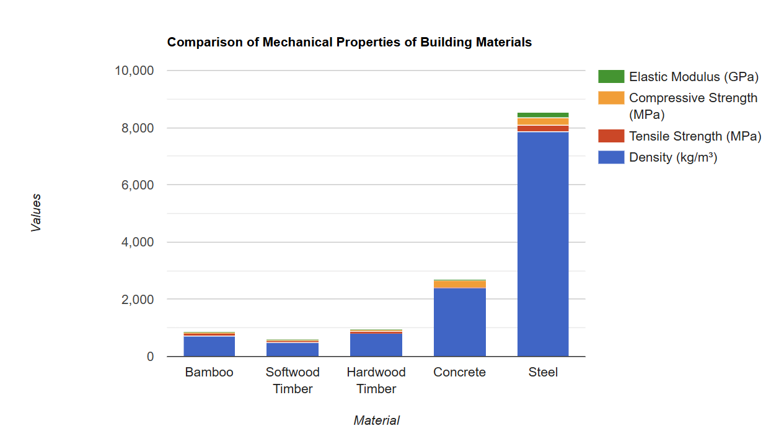
ANALYSIS AND DISCUSSION
Density:
Bamboo: 700 kg/m³
Lighter than concrete (2400 kg/m³) and steel (7850 kg/m³).
Heavier than softwood (500 kg/m³), similar to hardwood (700-1200 kg/m³).
Ideal for lightweight structures, especially earthquake-resistant walls.
Strength:
Bamboo withstands stress up to 100 MPa.
Double the strength of softwood (50 MPa) and slightly stronger than hardwood (80 MPa).
Does not match steel (250 MPa) but is perfect for scaffolding due to its strength and lightness.
Elastic Modulus:
Bamboo's modulus of elasticity is around 20 GPa.
Stiffer than softwood (12 GPa) and hardwood (14 GPa).
Not as stiff as concrete (30 GPa) or steel (200 GPa).
Combines stiffness and flexibility, ideal for lightweight structures like bridges and roofs.

Slide 4
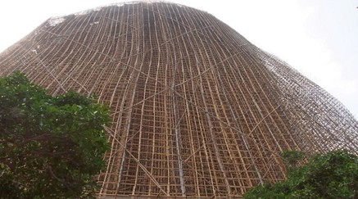
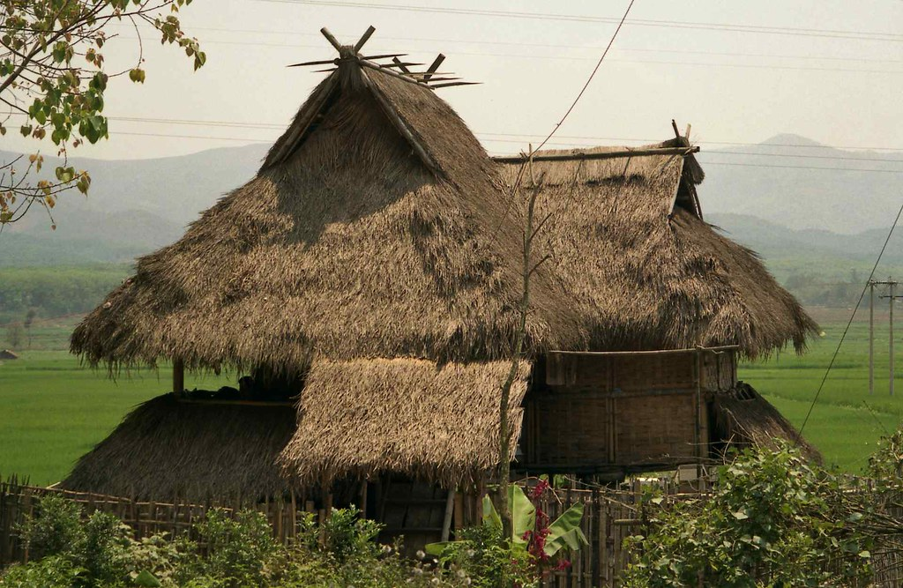
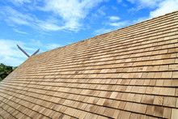
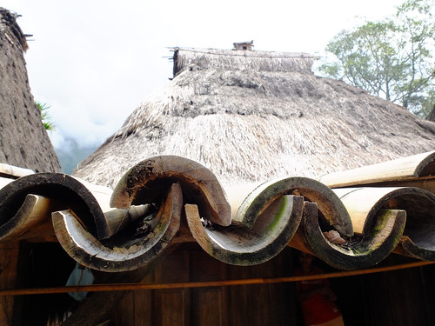
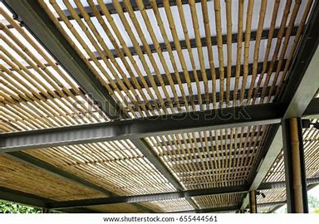

APPLICATION IN CONSTRUCTION
1. Scaffolding: 2. Roofing
3. Bridges:
- Thatch roof
-Flattened bamboo shingles
-Halved bamboo roof
-Bamboo-metal hybrid roof
This Photo by Unknown Author is licensed under CC BY-SA

Slide 5
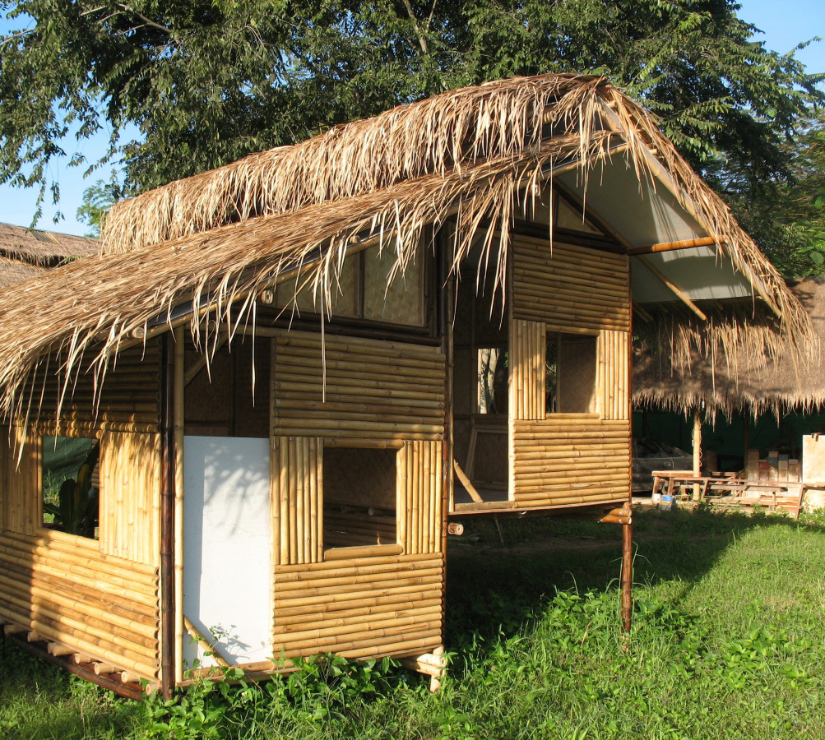
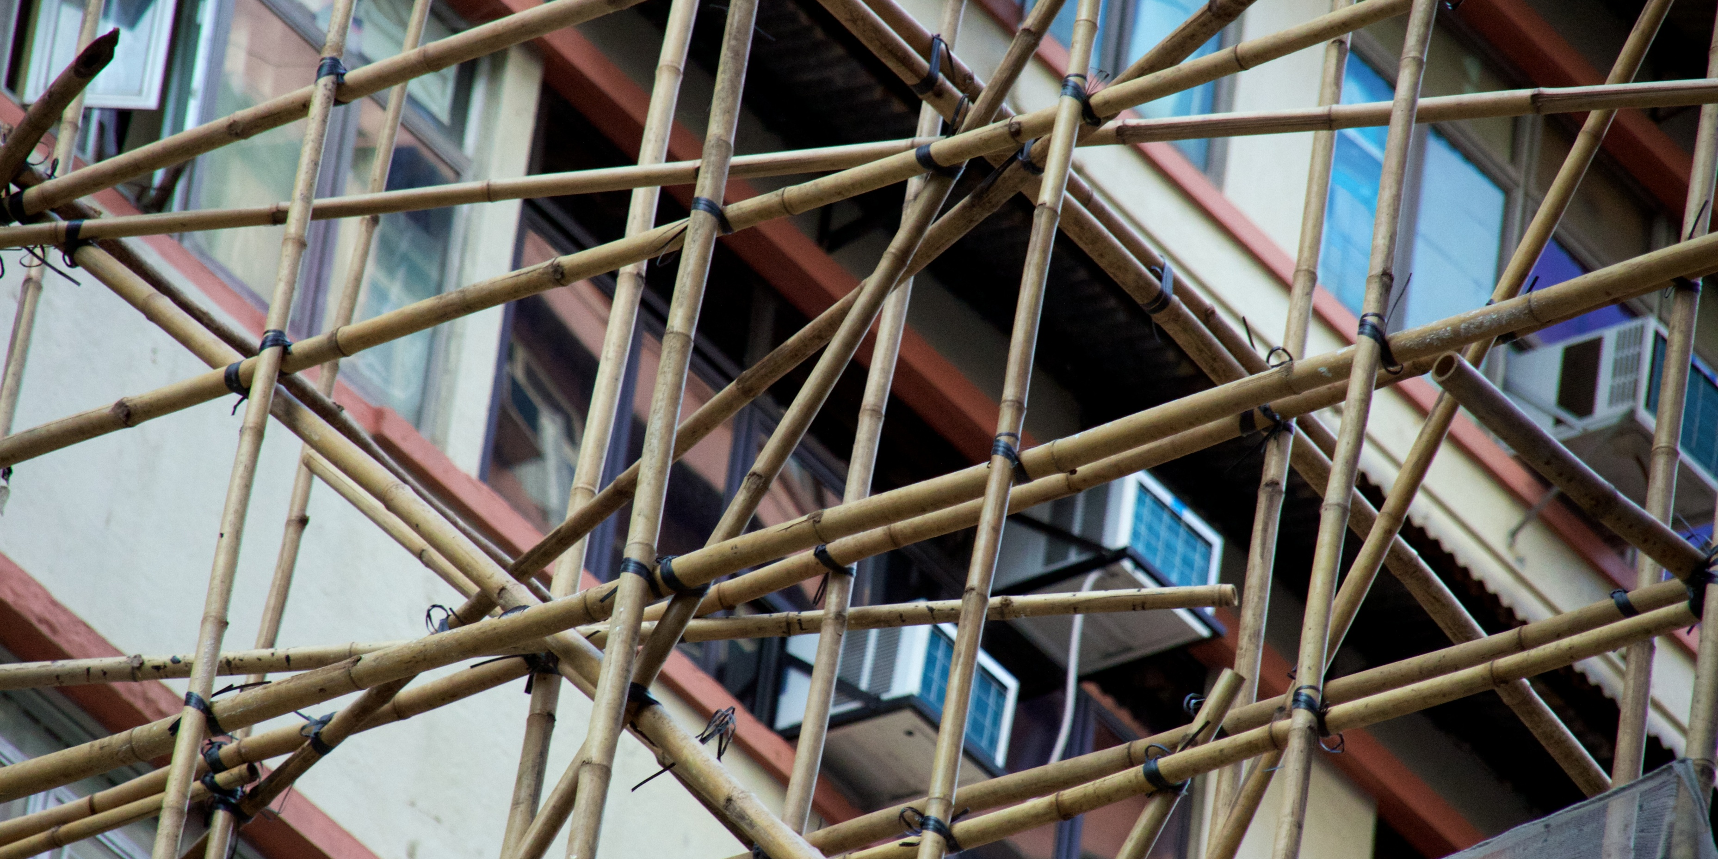
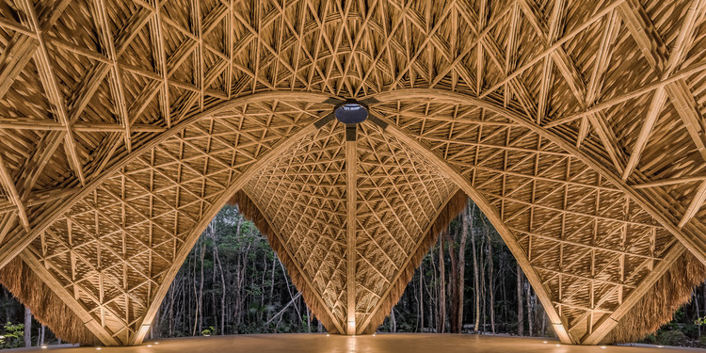
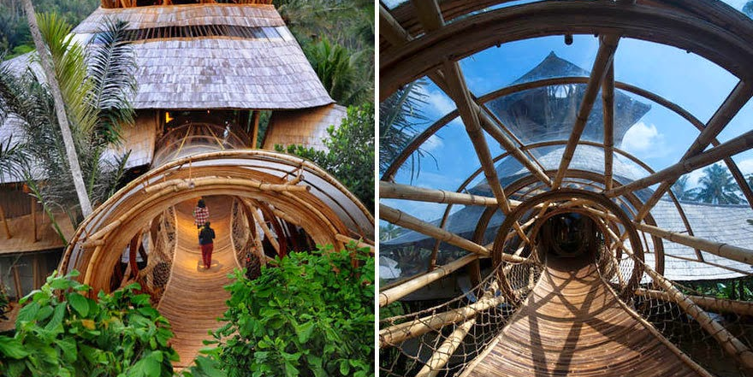
CONCLUSION
Bamboo stands out as a sustainable building material, offering outstanding mechanical properties like high tensile strength and low density. Its versatility allows for diverse applications, from scaffolding to roofing solutions and resilient bridges. While there are challenges such as pest susceptibility, proper treatment can help resolve these issues. Overall, bamboo's strength, flexibility, and eco-friendliness makes it an optimal option in modern construction, paving the way for more sustainable engineering practices in the future.

